Slide 1
Application19.16 Discrete Location Problems

Slide 2
Content
Introduction
Discrete Location Problems
Solution methods
Related problems

Slide 3
Introduction
Problem description:
1
1
1
Select p sites for new facilities
2
2
2
2
existing
facilities
……
……
New
facilities
available
sites
k
j
i
i
…
……
r
p
q
min total transportation cost between the new and existing facilities.

Slide 4

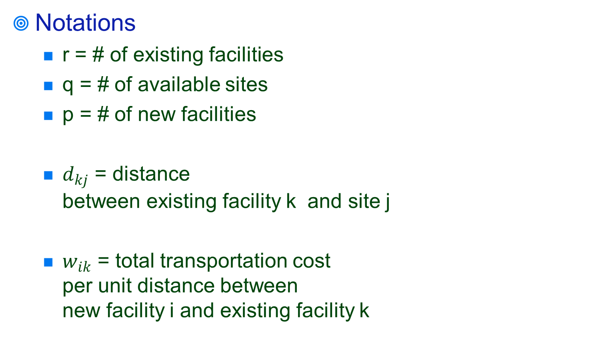
Solution methods
Notations
r = # of existing facilities
q = # of available sites
p = # of new facilities
$d_{kj}$ = distance between existing facility k and site j
$w_{ik}$ = total transportation cost per unit distance between new facility i and existing facility k
1
1
2
2
$$d_{kj}$$
……
……
k
j
…
……
r
q
existing
facilities
available
sites

Slide 5
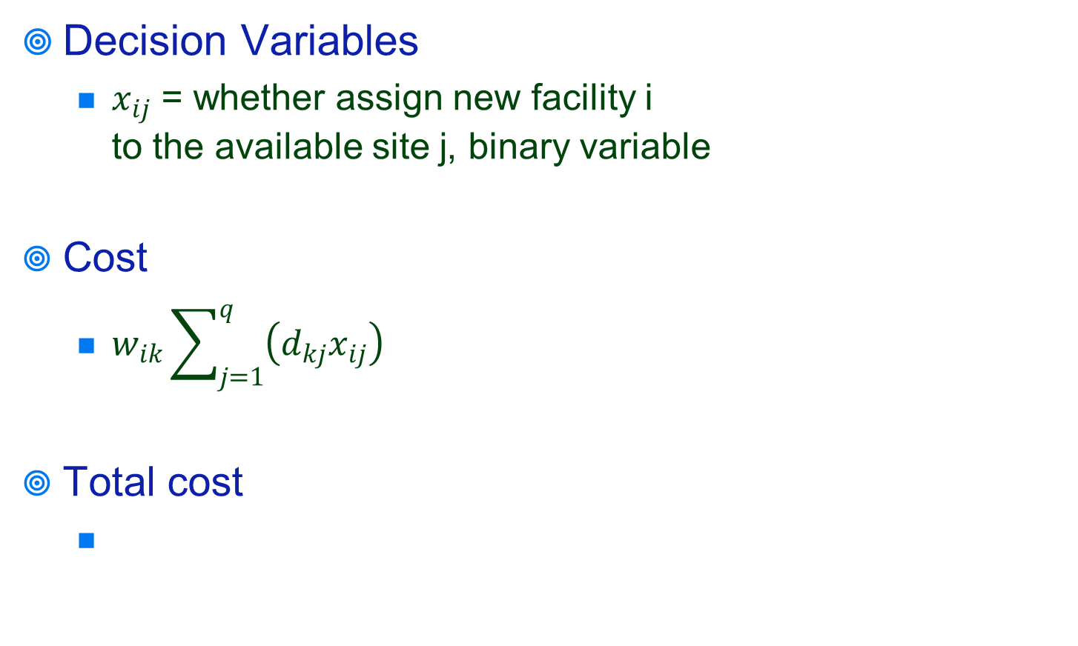
Solution methods
Decision Variables
$x_{ij}$ = whether assign new facility i to the available site j, binary variable
Cost
$w_{ik}\sum_{j=1}^{q}{\left(d_{kj}x_{ij}\right)}$
Total cost
1
1
2
2
$$d_{kj}$$
……
……
k
j
…
……
r
q
existing
facilities
available
sites

Slide 6
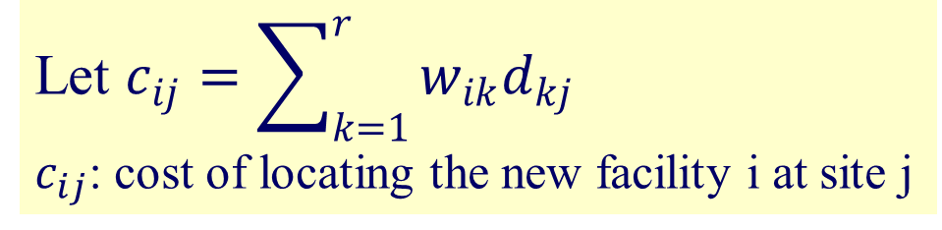
Solution methods
1
1
2
2
……
……
Let $c_{ij}=\sum_{k=1}^{r}{w_{ik}d_{kj}}$
$c_{ij}$: cost of locating the new facility i at site j
k
j
…
……
r
q
assignment problem
available
sites
existing
facilities

Slide 7
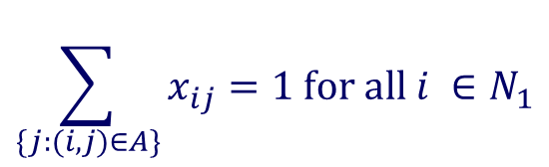

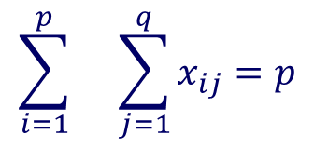
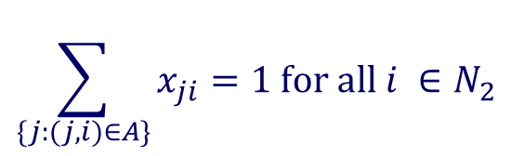
Solution methods
assignment problem (min-cost flow problem)
1
1
$$min$$
2
2
$$\sum_{\{j:(i,j)∈A\}}{x_{ij}}=1 for all i ∈N_{1}$$
……
……
k
j
$$\sum_{\{j:(j,i)∈A\}}{x_{ji}}=1 for all i ∈N_{2}$$
…
……
r
q
$$\sum_{i=1}^{p}{}{\sum_{j=1}^{q}{x_{ij}}}=p$$
existing
facilities
available
sites

Slide 8
Related problems
Integer Programming formulations of discrete hub location problems.
James F. Campbell, 1992.
European Journal of Operation Research 72(1944)387-405.
On the complexity of locating linear facilities in the plane.
Nimrod Megiddo and Arie Tamir, 1982.
Operations Research.

Slide 9
Thanks for your listening!!!
Q&A

